Slide 2

Santhosh Kumar (Sandy)
Data Engineer, Cognizant
Microsoft Certified Trainer
3 Azure Hackathon winner

Slide 3
Make payments from inside Microsoft Teams
By Santhosh Kumar

Slide 4
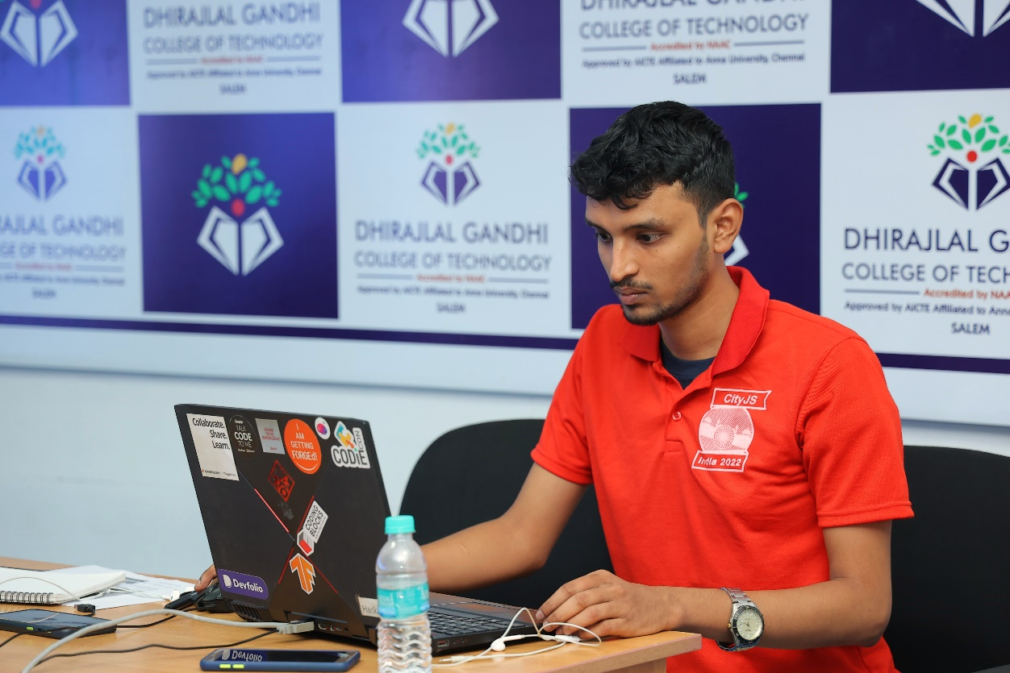
About Me
Working as a Data Engineer (Core Python)
3rd Prize in Citi Digital Innovation Challenge 2022 (~$2000)
Winner of Deepgram X DEV Hackathon 2022 ($1500)
Winner of Microsoft Azure Trail Hackathon 2022 ($1500)
Winner of Azure Developer Stories 2021 (Microsoft Surface Pro X)
Winner of Azure Community Conference 2021 – Hackathon (Microsoft Surface Go 2)
Microsoft Certified Trainer 2021-2022, 2022-2023
Microsoft Certified Professional with six Azure certifications
Curious to learn new tech; Engage in hackathons and meetups
I love helping and talking to like-minded people
Participated in 10+ hackathons

Slide 5
Random Fact
Azure Community Conference 2020 – was listening to speakers
Azure Community Conference 2021- Won 1st prize in AzConf Hackathon
Finally, I’m speaking at Azure Community Conference 2022 today!

Slide 6
Agenda
Why on Teams and what it offers?
Architecture of the solution
Azure Services Used
Live Demo
Open for questions

Slide 7
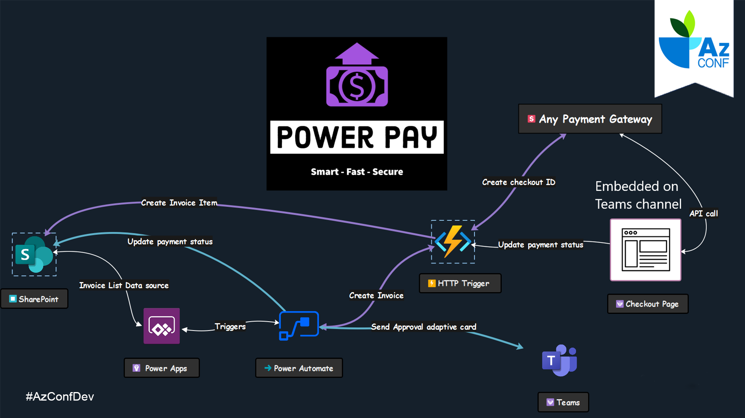

Slide 8
Azure Services Used
Power Apps - a No/Low code platform
Power Automate - Workflow automate
Adaptive Card - seamless integration with Power Automate
Azure Function - Runs Python code to manage all the backend services for robust usage
SharePoint - using it as a database for storing data

Slide 9
Let’s swing into action! Shall we!
Source code on GitHub - github.com/Santhoshkumard11/power-pay-with-Rapyd

Slide 10

Platinum Partner

Slide 11
Q&A

Slide 12
Thank You!
Make payments from inside Microsoft Teams
Santhosh Kumar Dhanasekaran
Data Engineer, Cognizant

